Slide 1

Sagi Eden, Omer Nizri
Hybrid Recommender System based on Autoencoders: Integrating together users and items Metadata
Prof. Bracha Shapira

Slide 2
Related Work & Background

Slide 3
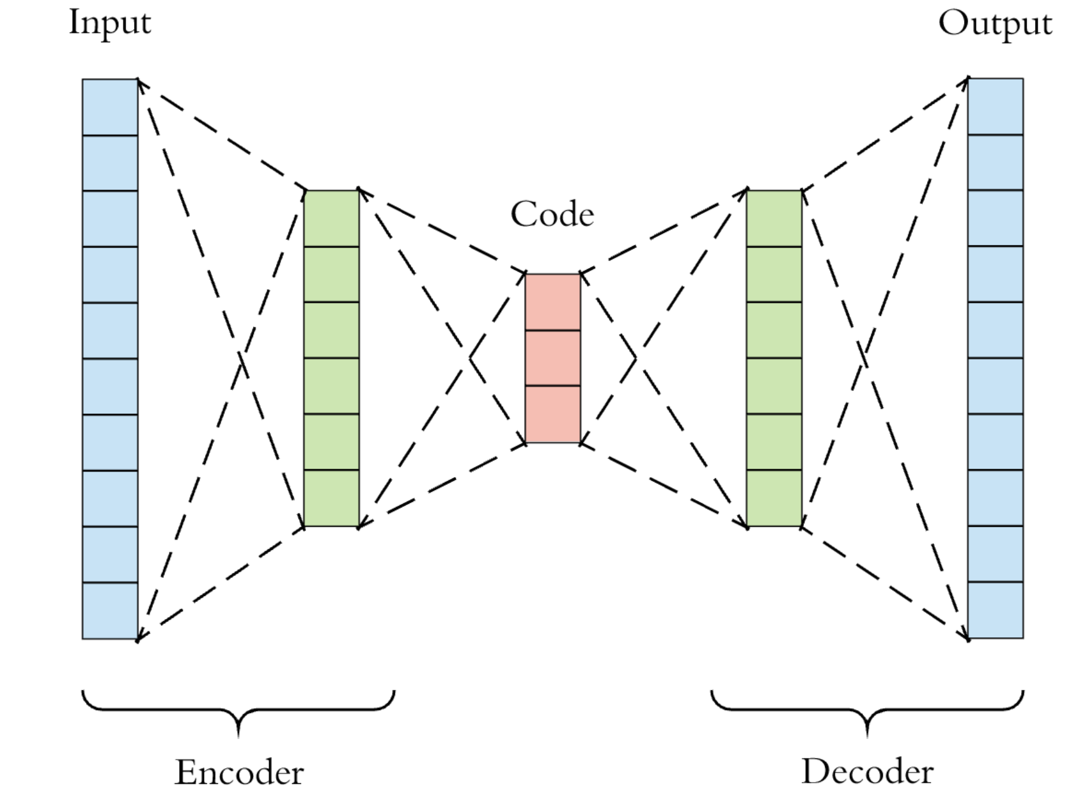
Autoencoders (AE) Background
An Autoencoder is a type of artificial neural network used to learn efficient data codlings in an unsupervised manner.
The Auto-encoders perform non-linear dimensionality reduction and thus gives results that are superior to PCA for example.
Usually in Auto-encoders there are 2 phases:
Encoding – reduce dimensionality to a much smaller vector
Decoding – restore dimensionality to same size as input with purpose to reconstruct the input data
Bengio, Y., Lamblin, P., Popovici, D., & Larochelle, H. (2007). Greedy layer-wise training of deep networks. In Advances in neural information processing systems (pp. 153-160).
Notes:
מבצע הורדת מימד לא לינארית – לכן טוב יותר מפיסיאיי -

Slide 4
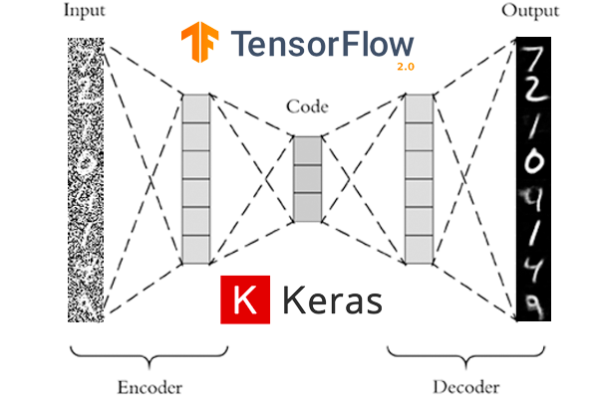
Denoising Autoencoder (DAE)
DAE take a partially corrupted input and are trained to recover the original undistorted input. In practice, the objective of denoising autoencoders is that of cleaning the corrupted input, or denoising. Two underlying assumptions are inherent to this approach:
Higher level representations are relatively stable and robust to the corruption of the input;
To perform denoising well, the model needs to extract features that capture useful structure in the distribution of the input
Vincent, P., Larochelle, H., Lajoie, I., Bengio, Y., & Manzagol, P. A. (2010). Stacked denoising autoencoders: Learning useful representations in a deep network with a local denoising criterion. Journal of machine learning research, 11(Dec), 3371-3408.
Notes:
הורדת רעש באמצעות השחתה חלקית של הקלט -
רובסטי -
מאלצים את המודל למצוא ייצוג טוב -

Slide 5
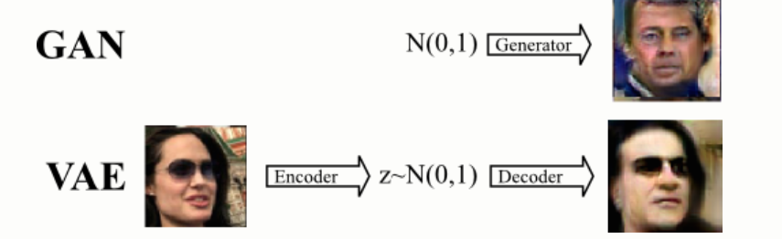
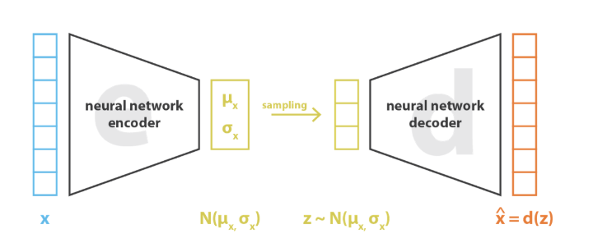
Variational Autoencoder (VAE)
Variational autoencoders (VAEs) [1] are generative models. Like Generative Adversarial Networks (GAN) [2] .
A variational autoencoder can be defined as being an autoencoder whose training is regularized to avoid overfitting and ensure that the latent space has good properties that enable generative process.
Training Process of VAE:
First, instead of encoding an input as a single point, it encode the input as a distribution over the latent space.
Second, a point from the latent space is sampled from that distribution
third, the sampled point is decoded, and the reconstruction error can be computed
finally, the reconstruction error is backpropagated through the network
[1] Kingma, D. P., & Welling, M. (2013). Auto-encoding variational bayes. arXiv preprint arXiv:1312.6114.
[2] Goodfellow, I., Pouget-Abadie, J., Mirza, M., Xu, B., Warde-Farley, D., Ozair, S., ... & Bengio, Y. (2014). Generative adversarial nets. In Advances in neural information processing systems (pp. 2672-2680).‏
Notes:
מודל גנרטיבי שנועד לוודא שהייצוג הלטנטי מספיק כללי -
יצירת ייצוג למרחב התפלגות במקום נקודה -

Slide 6
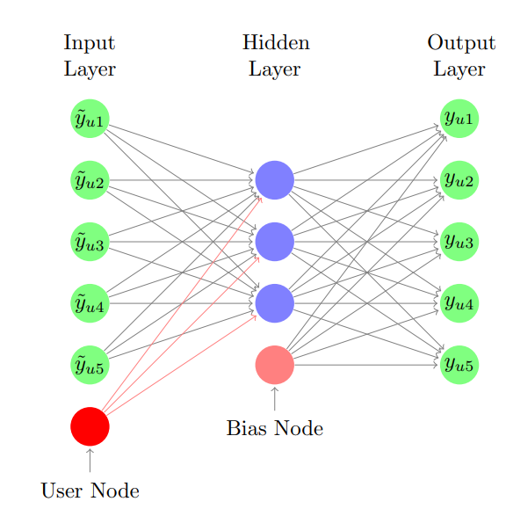
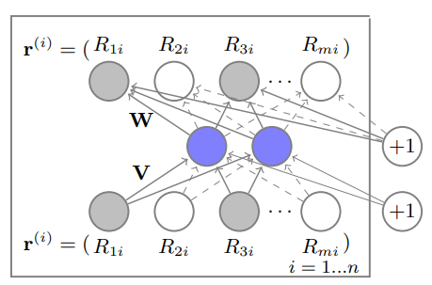
Autoencoders In
Recommendation Systems
Couple of papers paved the way for autoencoders into RS.
AutoRec: Solving rating prediction task. The paper purposed user-based model and item-based model.
CDAE: This paper proposed a novel model based on DAE for solving ranking task The model proposed integrates users' factors for solving Top-N recommendations
Both papers made an Adjustment in AE for RS:
The model gets as input instead of raw data/ features is a ratings vector (user-based model vector is the user ratings of all items, symmetric for item-based model), dense it and try to reconstruct it.
In the learning phase AutoRec also introduced masking technique for handling the unknown values such that the model learns only from known values (ratings).
Sedhain, S., Menon, A. K., Sanner, S., & Xie, L. (2015, May). Autorec: Autoencoders meet collaborative filtering. In Proceedings of the 24th international conference on World Wide Web (pp. 111-112).
Wu, Y., DuBois, C., Zheng, A. X., & Ester, M. (2016, February). Collaborative denoising auto-encoders for top-n recommender systems. In Proceedings of the Ninth ACM International Conference on Web Search and Data Mining (pp. 153-162).
Notes:
AutoRec – rating pred
CDAE -

Slide 7
Other Previous AE Work in RS
Other forms of autoencoders have also been used for recommendation tasks:
AutoSVD++: A recent study that combines constructive autoencoders and matrix factorization to provide recommendations based on content data and implicit user feedback
CDL: A hierarchical Bayesian model which integrates stacked denoising autoencoder (SDAE) into probabilistic matrix factorization
CVAE: A variational autoencoder that learns the deep latent representation and the implicit relationship between users and items from ratings and content data
Our Method Differ from these algorithms as it integrate both users and items self information into one DAE Model.
Wang, H., Wang, N., & Yeung, D. Y. (2015, August). Collaborative deep learning for recommender systems. In Proceedings of the 21th ACM SIGKDD international conference on knowledge discovery and data mining (pp. 1235-1244).‏
Zhang, S., Yao, L., & Xu, X. (2017, August). AutoSVD++ An Efficient Hybrid Collaborative Filtering Model via Contractive Auto-encoders. In Proceedings of the 40th International ACM SIGIR conference on Research and Development in Information Retrieval (pp. 957-960).‏
Li, X., & She, J. (2017, August). Collaborative variational autoencoder for recommender systems. In Proceedings of the 23rd ACM SIGKDD international conference on knowledge discovery and data mining (pp. 305-314).‏
Notes:
AutoSVD++ - integrate items_side info into item representation. Item side info is the hidden layer learned in AE
CDL – SDAE while inserting sampled noise in each layer (input: implicit feedback ( watched – not watched)), try to predict watched – not wachted

Slide 8
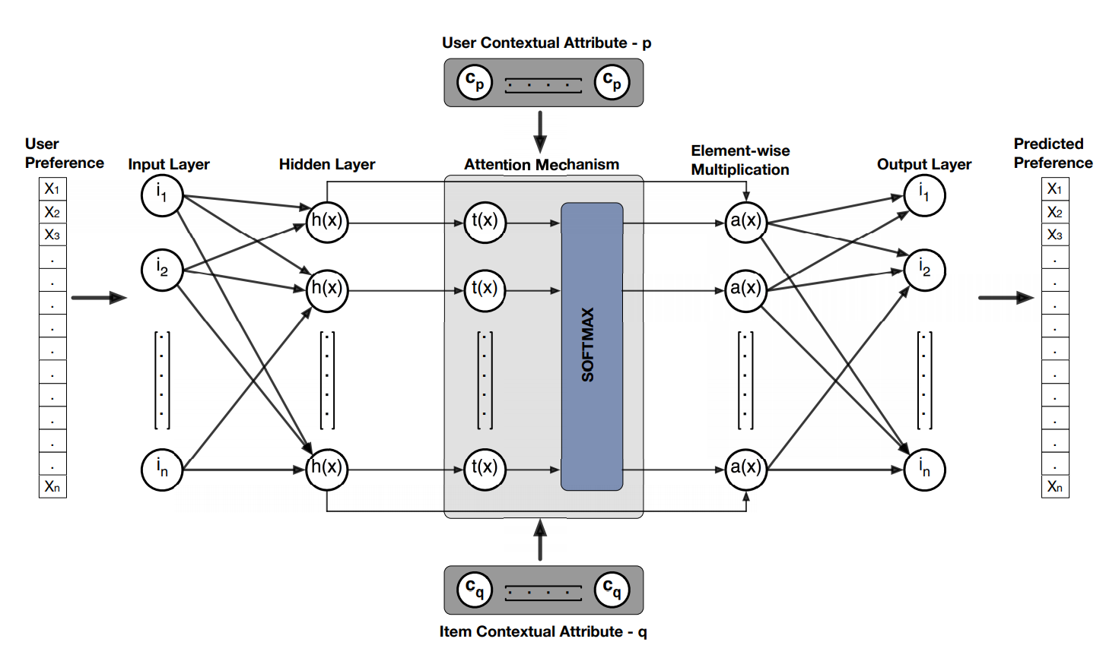
Related Work:
Attentive Contextual Denoising Autoencoder for Recommendation
A recent paper (September 2018) published integrated both user and item self information in DAE .
Our Improvement Differ from that paper in 2 Things:
The Model Suggested by Y. Jhamb uses the features as context and use it as Attention for user’s hidden representation vector.
The Model choose for each user subset of items from past user interaction to extract features from or integrate general context for item, while our suggestion takes into account all of the item's self information
Jhamb, Y., Ebesu, T., & Fang, Y. (2018, September). Attentive contextual denoising autoencoder for recommendation. In Proceedings of the 2018 ACM SIGIR International Conference on Theory of Information Retrieval (pp. 27-34).‏
Notes:
Features as context
For each user choose subset of items

Slide 9
Main Paper Review

Slide 10
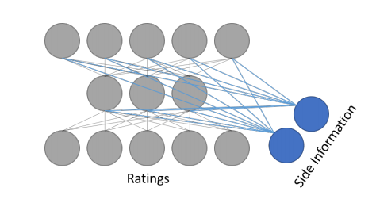
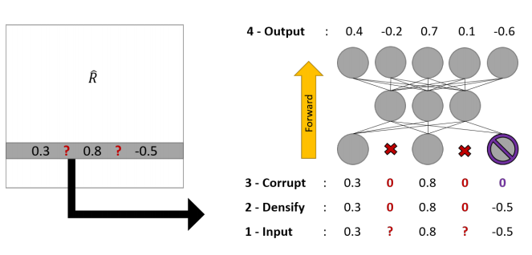
Main Paper:
Hybrid Recommender System based on Autoencoders
The algorithm suggested 2 types of DAE Models for Rating Prediction. U-CFN (users based) and V-CFN (items based).
both models integrated the side-information as concatenation in each layer at the DAE, while U-CFN integrated only users side information and V-CFN integrated only items side information.
The Limitation of this Algorithms is that it The Architecture of the Model Doesn’t Allow it to Integrate Both Side Information at Once, And Force to choose between 2 Models
Strub, F., Gaudel, R., & Mary, J. (2016, September). Hybrid recommender system based on autoencoders. In Proceedings of the 1st Workshop on Deep Learning for Recommender Systems (pp. 11-16).‏‏

Slide 11
Main Paper:
Hybrid Recommender System based on Autoencoders
As We showed before the paper is one of the firsts to combine side-information to DAE, but other papers that combines side info has been published since then. [1]
Limitations:
choose side information only from user or only from item.
If choosing item side info, the train process must be items driven, in opposed to user driven that is more popular.
[1] Jhamb, Y., Ebesu, T., & Fang, Y. (2018, September). Attentive contextual denoising autoencoder for recommendation. In Proceedings of the 2018 ACM SIGIR International Conference on Theory of Information Retrieval (pp. 27-34).‏

Slide 12
Main Paper:
Hybrid Recommender System based on Autoencoders
Dataset tested:
- MovieLens: (1M, 10M, 20M) that is a very popular dataset, containing ratings of users on movies And side information on the movies.
- Douban: also contains movies ratings very popular dataset that and provides side information on the users
Evaluation method:
The Evaluation was Mainly RMSE on the rating prediction task.
In addition they compared Running Time and Memory used between the algorithms.
One of the Conclusions they reached is that the I_CFN outperformed U_CFN.
The I_CFN seemed to outperformed other AE Based algorithms for rating prediction.

Slide 13
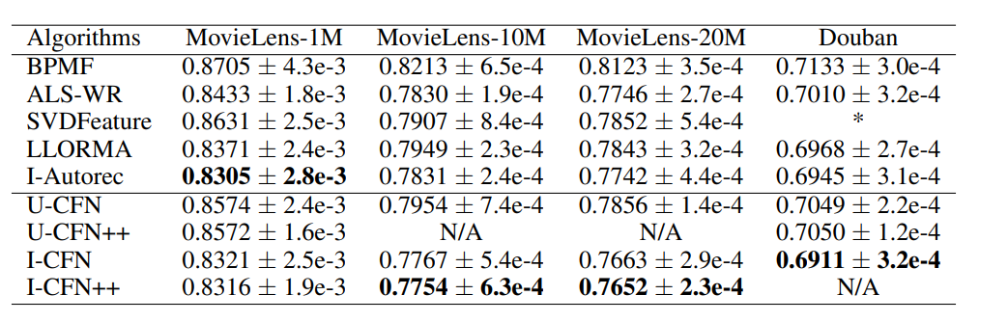
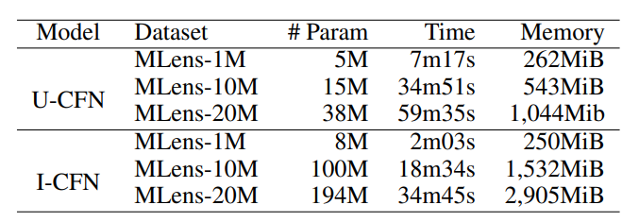
Main Paper Results:
Hybrid Recommender System based on Autoencoders
RMSE on MovieLens-10M (90%/10%). The ++ suffix denotes when side information is added to CFN

Slide 14
Suggested Improvement

Slide 15
Architecture
NN Node
Input Masked Node
Denoising Masked Node
Side-info Node
Side-info vector

Slide 16
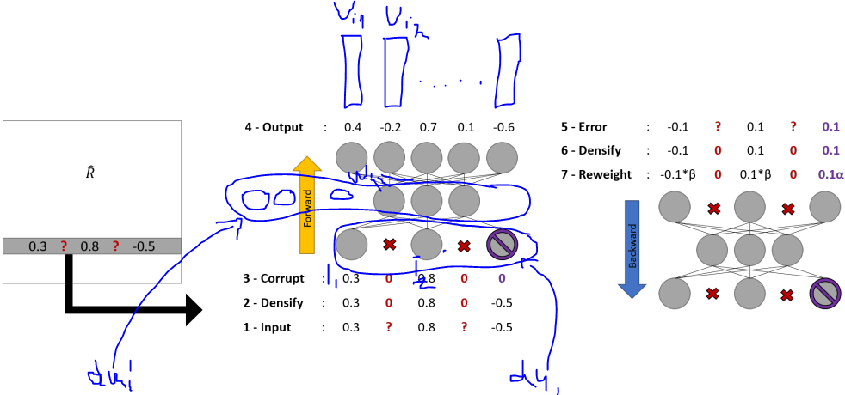
Suggested Improvement
Vi1 – item 1 side info
Vi2 – item 2 side info
Vi1’ = FCN(Vi1)
Dui – user rating history
dui’ – user encoded representation concatenated with user_side info
Wi1 – weights for multiplication for item 1
Original Paper predicted rating (U-CFN) : Ri1 = (w1 * dui’)
Ours predicted rating: Ri1 = (Vi1’ + w1) * dui’

Slide 17
Suggested Improvement Explanation
Motivation:
When we add the items side info to the weights, we considering both the CF part of algorithm (the weights) and the content base (side info). By that we get a stronger representation for each user and item.
We believe that because of the stronger representation ,we will improve the results in general, And since we integrating content, we believe we will improve mostly on cold items (movies that few people watch).
Notes:
Stronger representation
Better on cold items

Slide 18
Suggested Improvement Evaluation
Evaluation:
Phase 1: using movielens database - Combine the item side info as we proposed to the U-CFN model.
Phase 2: using amazon database – we plan to extract NLP features from reviews as side info both user’s and item’s
Furthermore, We plan to compare RMSE on “cold items” and see if we improve rating prediction on cold items.
We are planning to evaluate our algorithm with RMSE on 2 phases.

Slide 19

Questions?

